Slide 1
Digital Media Report
South Texas College
March 2020
Prepared April 15, 2020

Slide 2
Digital Media Budget 2019-2020

Slide 3
Campaign Notes
— Overall impressions jumped from 2.7 million in February to 2.8 million in March
— Impressions went up because STC is grabbing more market share now while we assume competition is cutting their budgets. With this came a cheaper cost per click, allowing more site traffic.
— STC had a huge jump in completed video views across FB/IG, OTT and YouTube. This tells us that even though people are home, it has a captive audience now, more than before, as people are engaging more. Completed video views increased from 89,095 in February to 114,951 completed video views.
— While we did see some decreases in the PPC campaign, that is to be expected during COVID-19 isolation. The student journey might be longer now, but STC is building its funnel for when the campuses opens.
— STC’s cost per contact is still well below the national average. The cost per contact in March was $36, much lower than it was in November at $45 per contact, and still well below the industry average of $72. STC’s average call length jumped from 3:02 in February to 5:12 in March, which tells us people are engaged.

Slide 4
Pay Per Click — Main
18,054
IMPRESSIONS
2,356
CLICKS TO
WEBSITE
86
CALLS
39
FORM
SUBMITS
13.05%
CLICK THROUGH %
2-3%
INDUSTRY AVG.

Slide 5
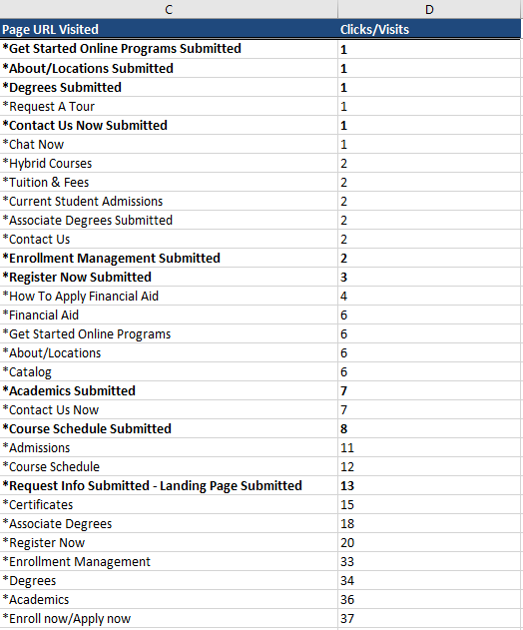
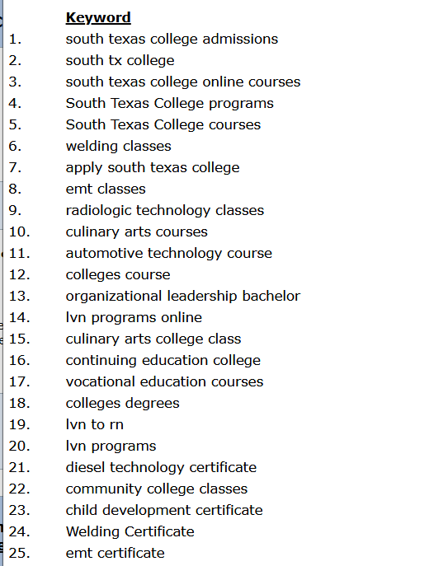
Pay Per Click — Main Campaign

Slide 6
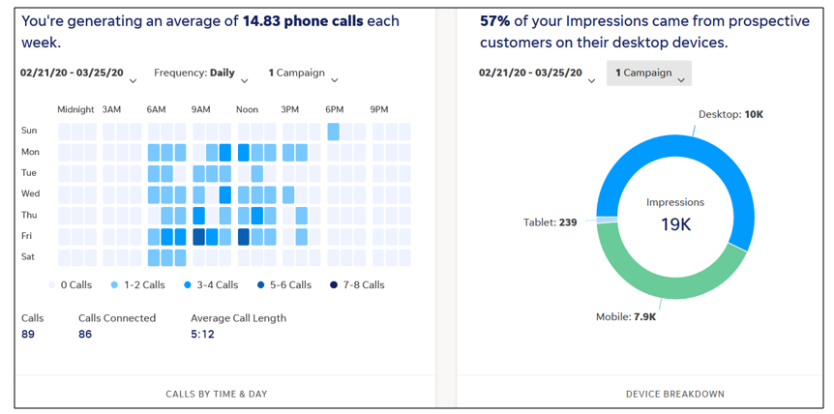
Pay Per Click — Main Campaign

Slide 7
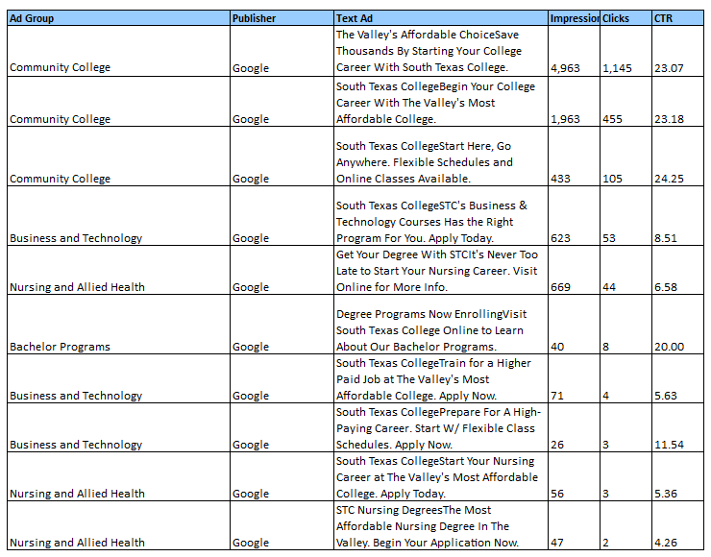
Pay Per Click — Main Campaign

Slide 8
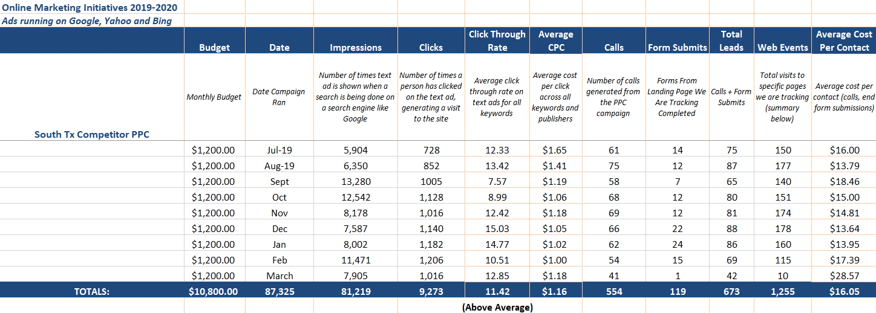
Pay Per Click —Competitor
7,905
IMPRESSIONS
1,016
CLICKS TO
WEBSITE
41
CALLS
1
FORM
SUBMITS
12.85%
CLICK THROUGH %
2-3%
INDUSTRY AVG.

Slide 9
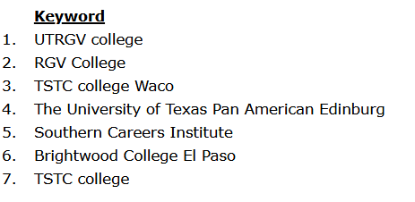
Pay Per Click — Competitor
Pay Per Click

Slide 10
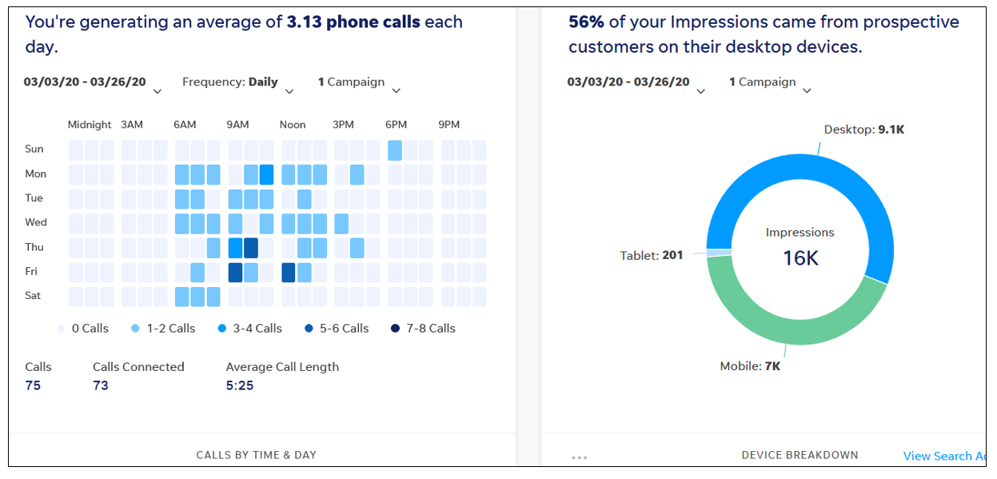
Pay Per Click — Competitor
Pay Per Click

Slide 11
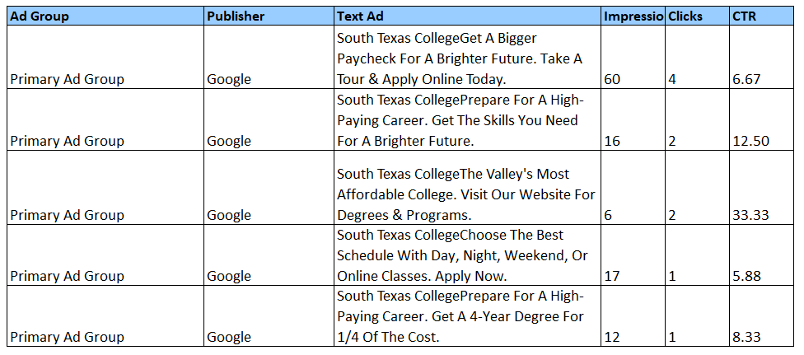
Pay Per Click — Competitor
Pay Per Click

Slide 12
Display — Main Campaign
938,400
IMPRESSIONS
3,053
CLICKS TO WEBSITE
264
GEOFENCING WALK-INS
$7.25
CPM
24,045
VIDEO VIEWS
19,287
100% VIDEO VIEWS
80.29%
COMPLETION RATE
15%
INDUSTRY AVG.

Slide 13
Display — Main Campaign
Tactic Performance:

Slide 14
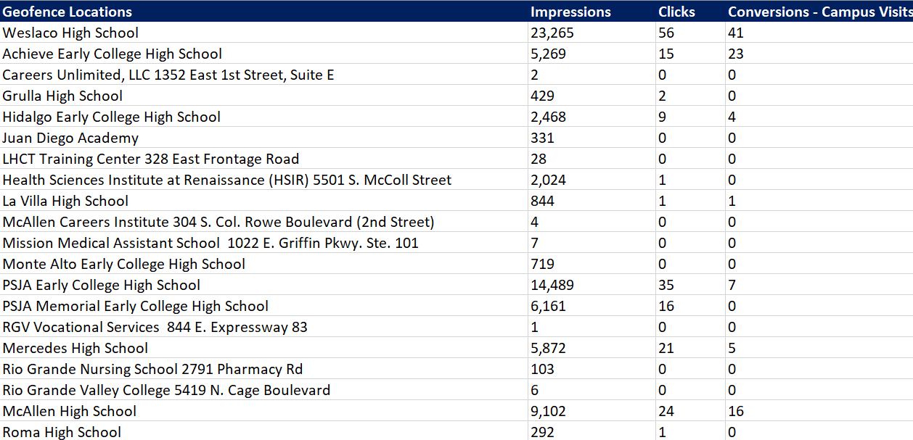
Display —Main Campaign

Slide 15
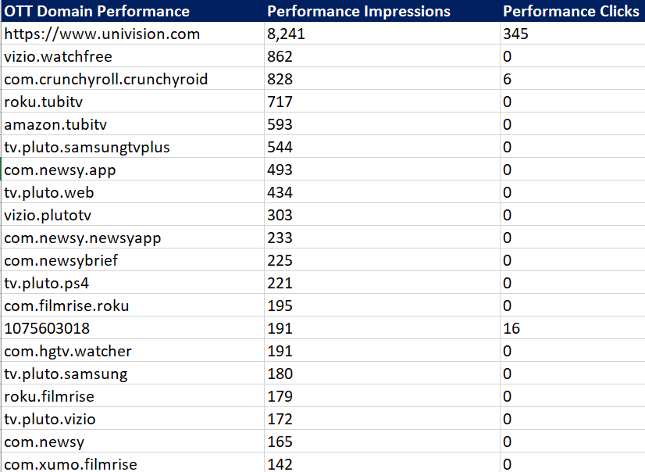
Display — Main Campaign

Slide 16
Display — Border Patrol Campaign
91,387
IMPRESSIONS
171
CLICKS TO WEBSITE
$5.96
CPM
Tactic Performance:

Slide 17
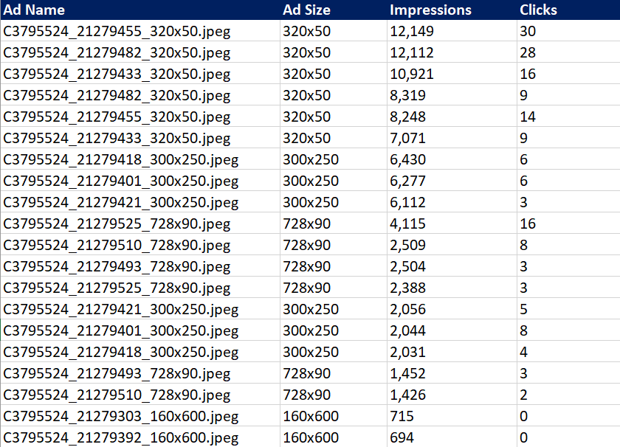
Display Border Patrol Campaign
Top Ad Performance:

Slide 18
Display Border Patrol Campaign
Geofence Performance:

Slide 19
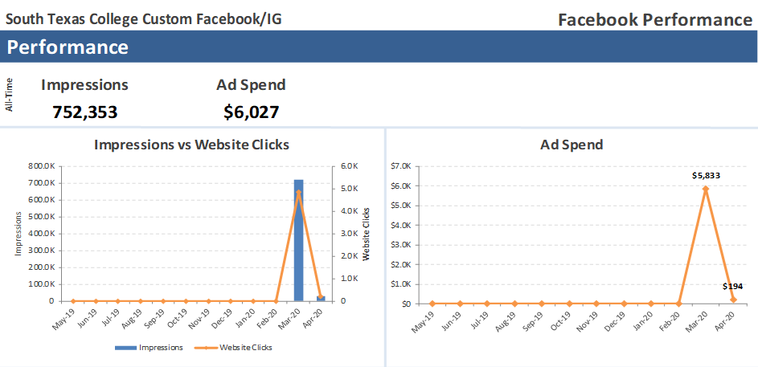
Facebook, Instagram & Retargeting
752,353
IMPRESSIONS
9,388
CLICKS TO WEBSITE
362
ENGAGEMENTS
7,801
100% VIDEO VIEWS

Slide 20
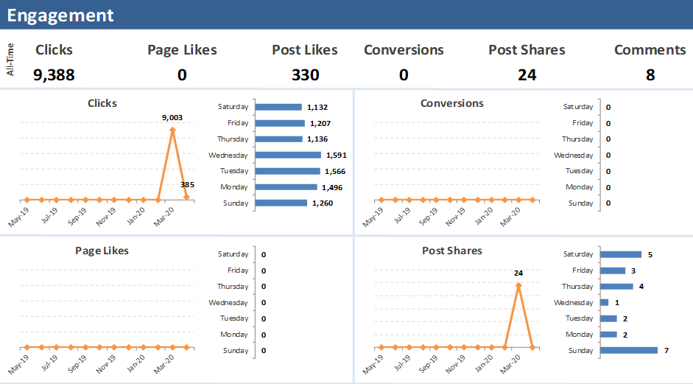
Facebook, Instagram & Retargeting

Slide 21
YouTube — English
123,577
IMPRESSIONS
63,138
100% VIDEO VIEWS
51.09%
COMPLETION RATE
15%
INDUSTRY AVG.
$0.04
COST PER VIEW
183
CLICKS TO WEBSITE

Slide 22
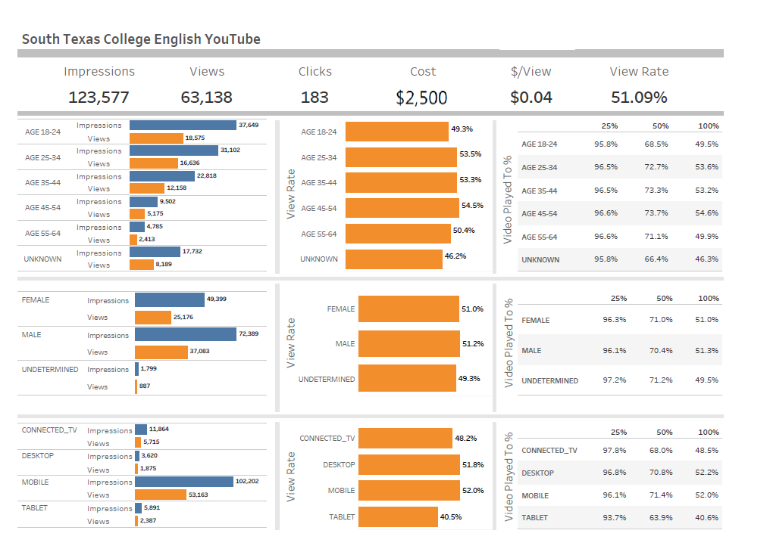
YouTube — English

Slide 23
YouTube — English

Slide 24
YouTube — Spanish
42,457
IMPRESSIONS
24,725
100% VIDEO VIEWS
58.24%
COMPLETION RATE
15%
INDUSTRY AVG.
$0.04
COST PER VIEW
94
CLICKS TO WEBSITE

Slide 25
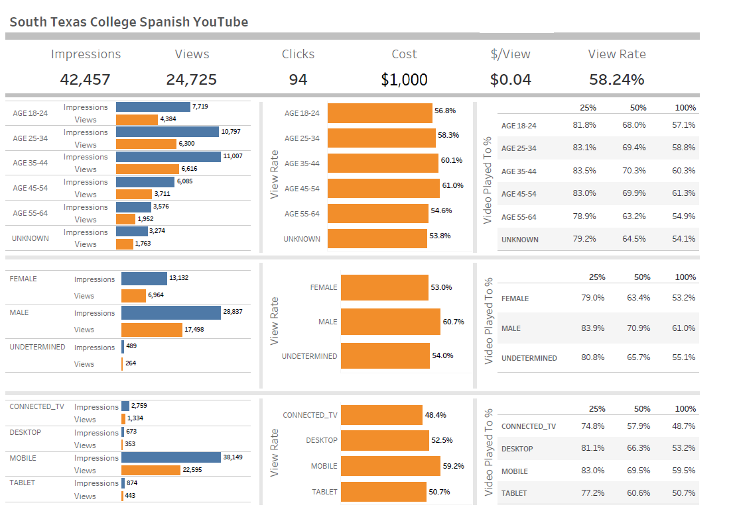
YouTube — Spanish

Slide 26
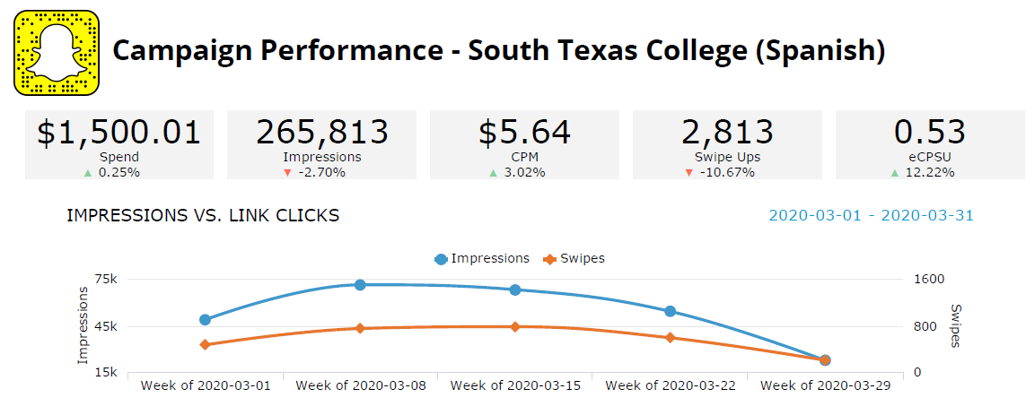
YouTube — Spanish
265,813
IMPRESSIONS
2,813
SWIPE-UPS/VISITS TO WEBSITE
$5.64
CPM
$0.53
CPSU/VISIT

Slide 27
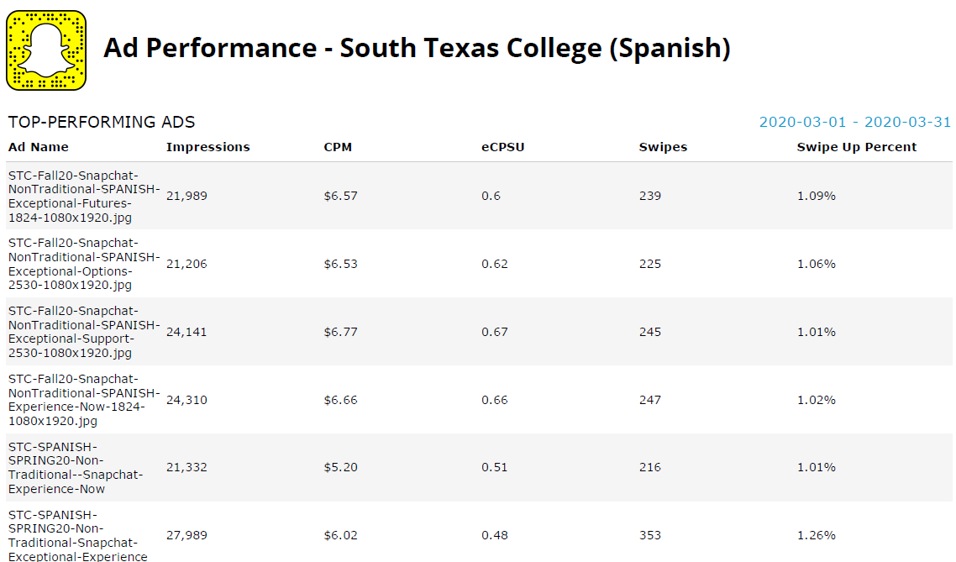
YouTube — Spanish

Slide 28
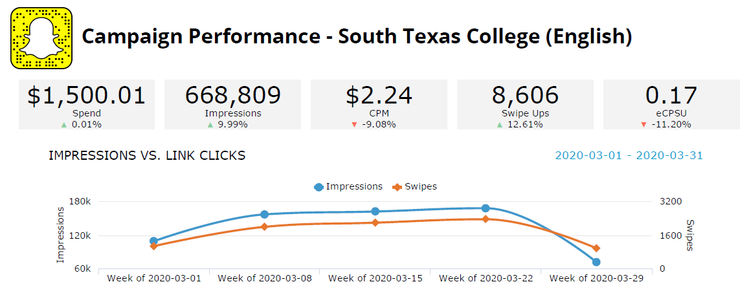
Snapchat — English
668,809
IMPRESSIONS
8,606
SWIPE-UPS/VISITS TO WEBSITE
$2.24
CPM
$0.17
CPSU/VISIT

Slide 29
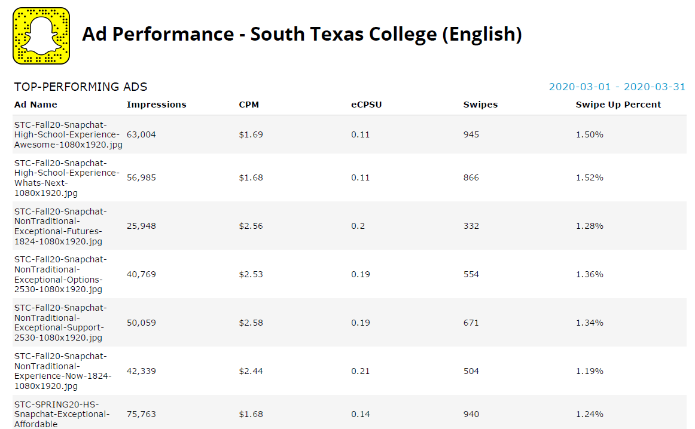
Snapchat — English

Slide 30
Combined Digital Campaign Totals
March 2020
2,908,755
IMPRESSIONS
27,680
CLICKS TO WEBSITE
114,951
100% VIDEO VIEWS
127
GENERATED CALLS
264
GEOFENCING WALK-INS
362
ENGAGEMENTS

Slide 31
Thank you!

